Slide 1
Tracing Your Cork Ancestors

Slide 2
Where do I begin?

Slide 3
Where do I begin?
Write down all the information you currently have

Slide 4
Where do I begin?
Write down all the information you currently have
Talk to relatives who might know more

Slide 5
Where do I begin?
Write down all the information you currently have
Talk to relatives who might know more
Create a to do list, letters to write, people to talk to, places to visit etc.

Slide 6
Where do I begin?
Write down all the information you currently have
Talk to relatives who might know more
Create a to do list, letters to write, people to talk to, places to visit etc.
Get to know the geography of Cork. Baronies, Civil Parishes and Townlands

Slide 7
Surnames
Are there any typical Cork surnames in your family tree?

Slide 8
Surnames
Are there any typical Cork surnames in your family tree?
Examples include McCarthy, Ahern, Buckley, O'Leary, O'Sullivan, Sheehan, Lynch, Crowley, Fitzgerald, Keating, Savage, Townsend and Murphy

Slide 9
1901 and 1911 Census
Currently only surviving pre-Independence historic census in full

Slide 10
1901 and 1911 Census
Currently only surviving pre-Independence historic census in full
Fragments of 1841 census survive for Cork but only include a handful of townlands

Slide 11
1901 and 1911 Census
Currently only surviving pre-Independence historic census in full
Fragments of 1841 census survive for Cork but only include a handful of townlands
Available for free online at http://www.census.nationalarchives.ie

Slide 12
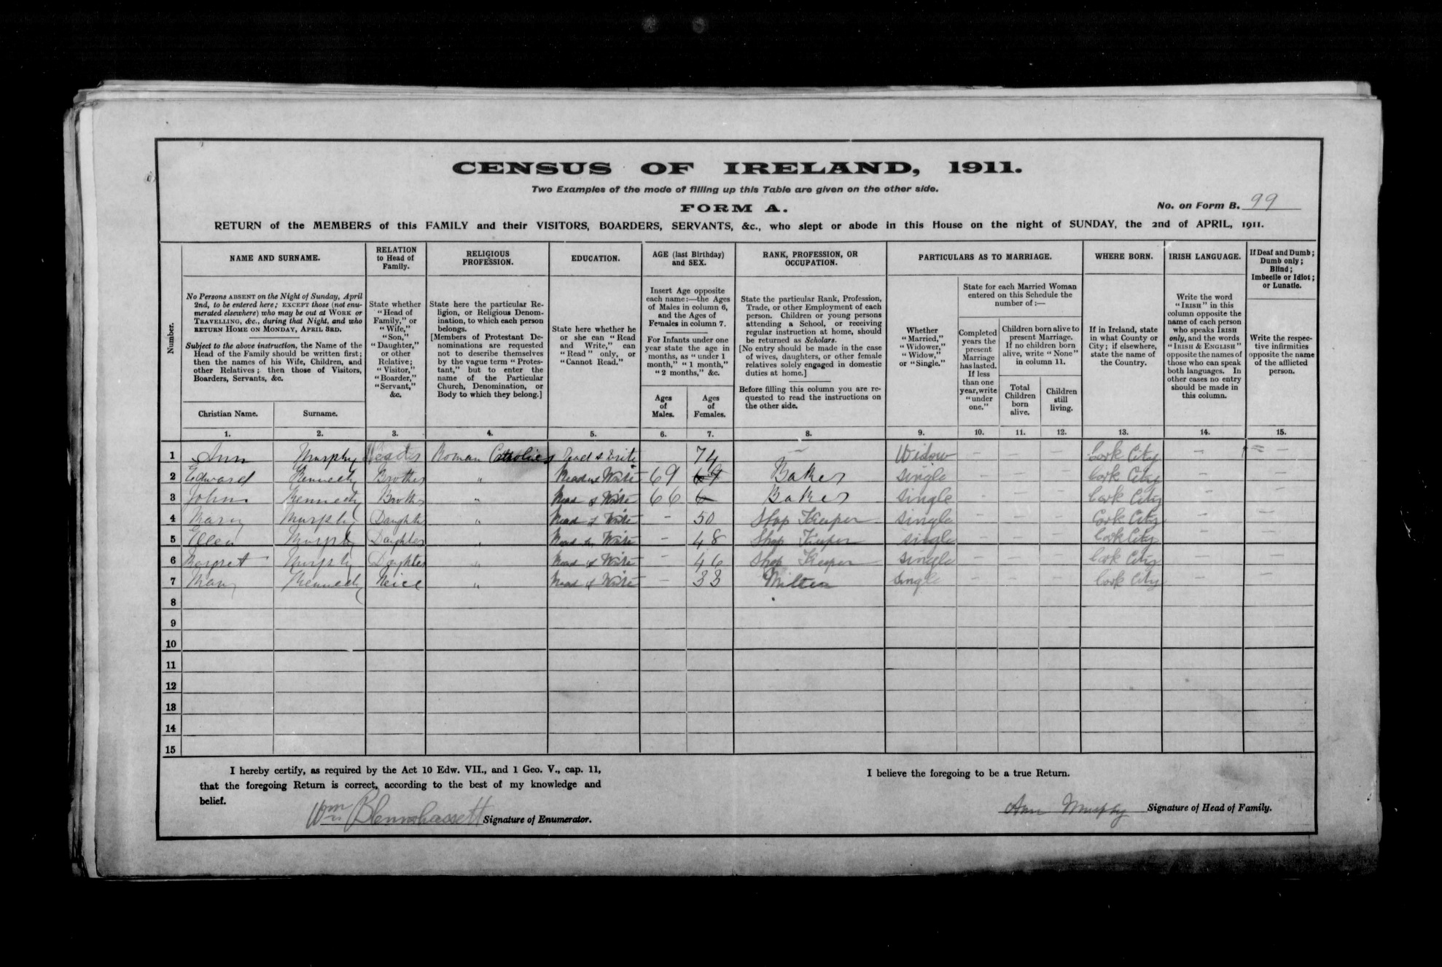

Slide 13
Land Records

Slide 14
Land Records
Griffith’s Valuation (also known as the Primary Valuation)

Slide 15
Land Records
Griffith’s Valuation (also known as the Primary Valuation)
Originals kept in National Library in Dublin but can be viewed for free online http://www.askaboutireland.ie/griffith-valuation/

Slide 16
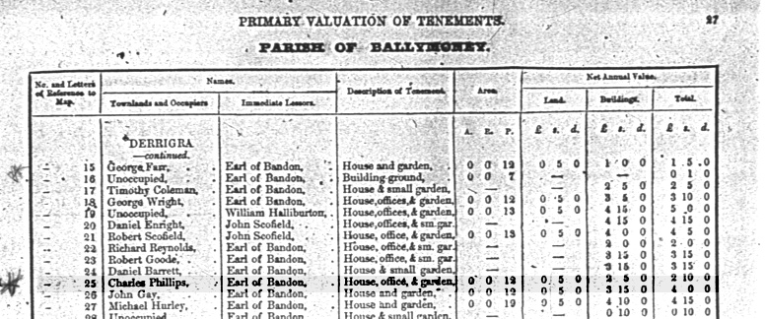

Slide 17
Land Records
Griffith’s Valuation (also known as the Primary Valuation)
Originals kept in National Library in Dublin but can be viewed for free online http://www.askaboutireland.ie/griffith-valuation/
Tithe Applotment Books

Slide 18
Land Records
Griffith’s Valuation (also known as the Primary Valuation)
Originals kept in National Library in Dublin but can be viewed for free online http://www.askaboutireland.ie/griffith-valuation/
Tithe Applotment Books
Cover the period from 1823 – 1837. Originals are kept in the National Archives but also available for free online http://titheapplotmentbooks.nationalarchives.ie

Slide 19
Parish Records

Slide 20
Parish Records
Original records of Catholic Church remain with the relevant parishes. Microfilms of Catholic registers are available at the National Library of Ireland for most Roman Catholic parishes in Ireland for the years up to 1880 and in some cases up to 1900

Slide 21
Parish Records
Original records of Catholic Church remain with the relevant parishes. Microfilms of Catholic registers are available at the National Library of Ireland for most Roman Catholic parishes in Ireland for the years up to 1880 and in some cases up to 1900
Only a third of Church of Ireland Parish registers survive and often remain with the relevant parishes. Registers may also be available in original or microfilm form at the Representative Church Body Library

Slide 22
Parish Records
Original records of Catholic Church remain with the relevant parishes. Microfilms of Catholic registers are available at the National Library of Ireland for most Roman Catholic parishes in Ireland for the years up to 1880 and in some cases up to 1900
Only a third of Church of Ireland Parish registers survive and often remain with the relevant parishes. Registers may also be available in original or microfilm form at the Representative Church Body Library
Roman Catholic and Church of Ireland records for Cork and Ross are available to consult for free on http://www.irishgenealogy.ie

Slide 23
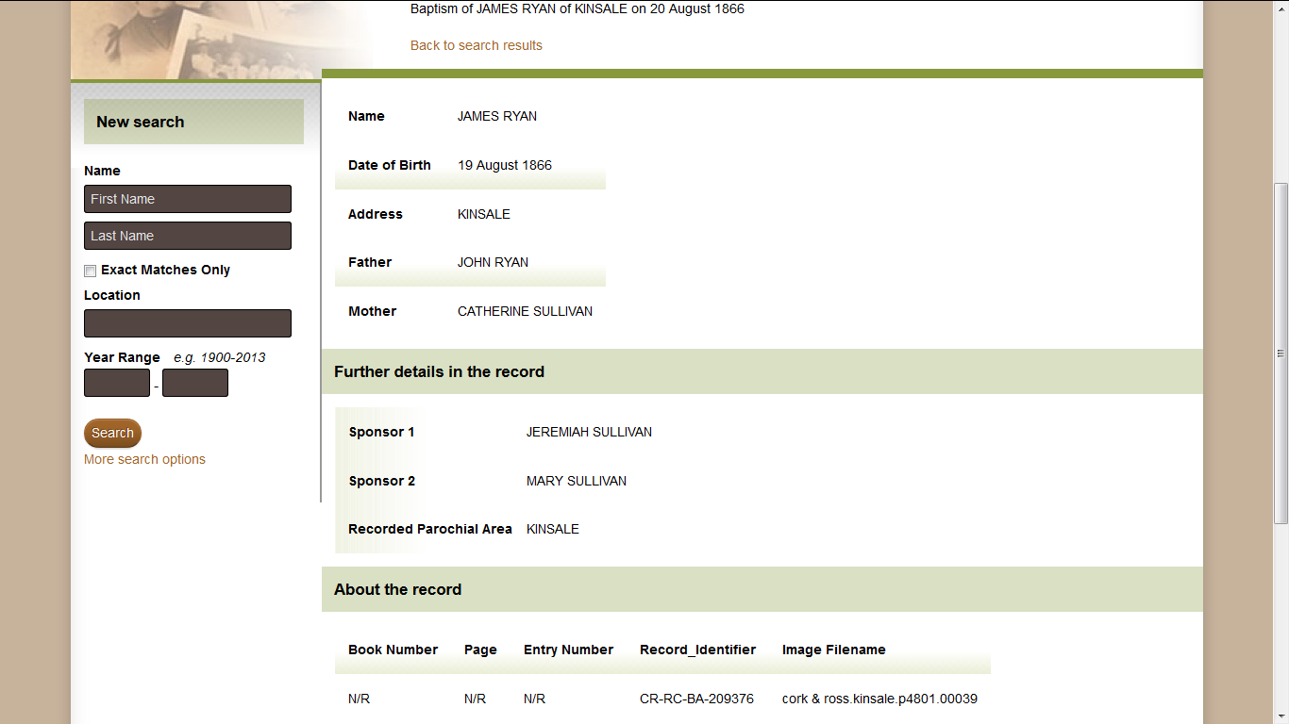

Slide 24
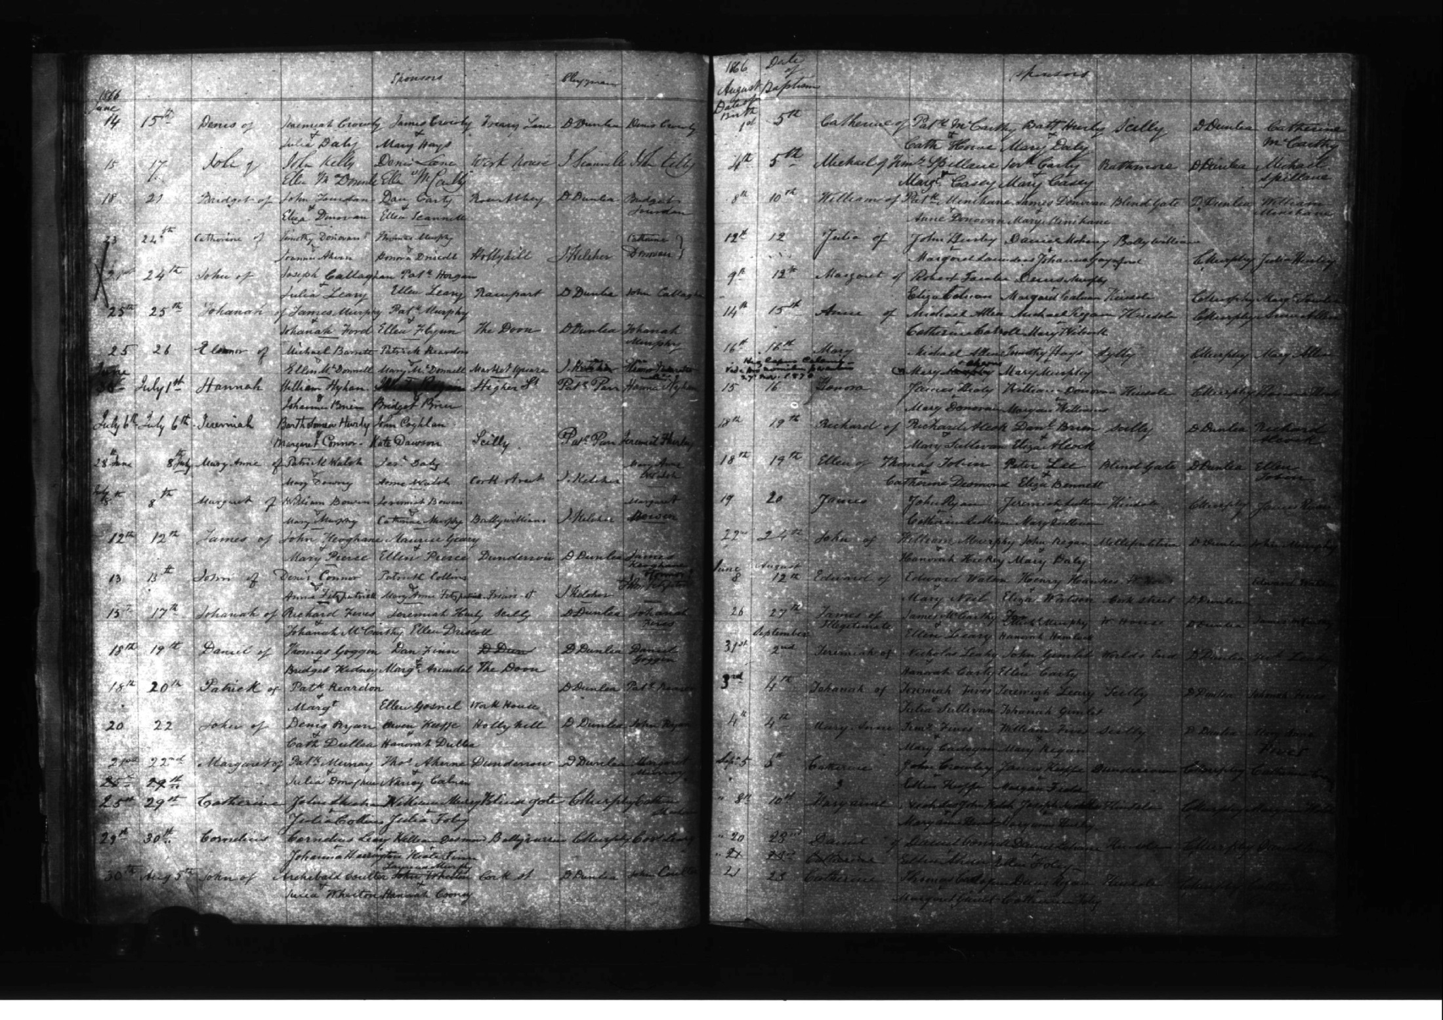

Slide 25
Parish Records
Roman Catholic and Church of Ireland records for Cork and Ross are available to consult for free on http://www.irishgenealogy.ie
Index of Civil Records will also be added to the website shortly
Cloyne records available in Mallow Heritage Centre

Slide 26
Archives and Libraries

Slide 27
Archives and Libraries
Cork City Library, Local History Department, Grand Parade. Closed Mondays and Tuesdays
http://www.corkpastandpresent.ie/

Slide 28
Archives and Libraries
Cork City Library, Local Studies Department, Grand Parade. Closed Mondays and Tuesdays
http://www.corkpastandpresent.ie/
Cork County Library, Carrigrohane Road. Offers a Family History service

Slide 29
Archives and Libraries
Cork City Library, Local Studies Department, Grand Parade. Closed Mondays and Tuesdays
http://www.corkpastandpresent.ie/
Cork County Library, Carrigrohane Road. Offers a Family History service. www.corkcoco.ie/library
Cork City and County Archives, Blackpool. http://corkarchives.ie/

Slide 30
Local Societies

Slide 31
Local Societies
Cork Genealogical Society. Meet on the second Thursday of every month in the LDS Family History Centre, Sarsfield Road Wilton. Also have members family history workshops. http://www.corkgenealogicalsociety.com/

Slide 32
Local Societies
Cork Genealogical Society. Meet on the second Thursday of every month in the LDS Family History Centre, Sarsfield Road Wilton. Also have members family history workshops. http://www.corkgenealogicalsociety.com/
Cork Branch, Western Front Association. Meetings held Rob Roy Pub, 28 Cook Street, Cork, at 7.30 p.m. on the last Wednesday of every month

Slide 33
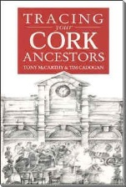
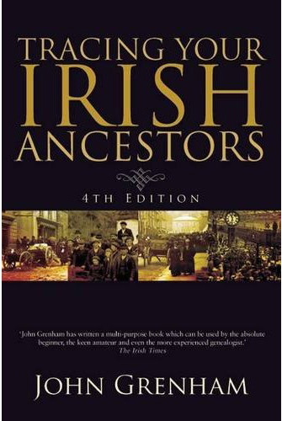
Publications

Slide 34
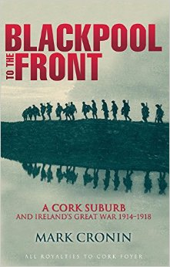
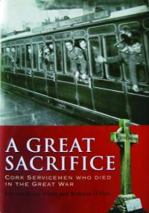
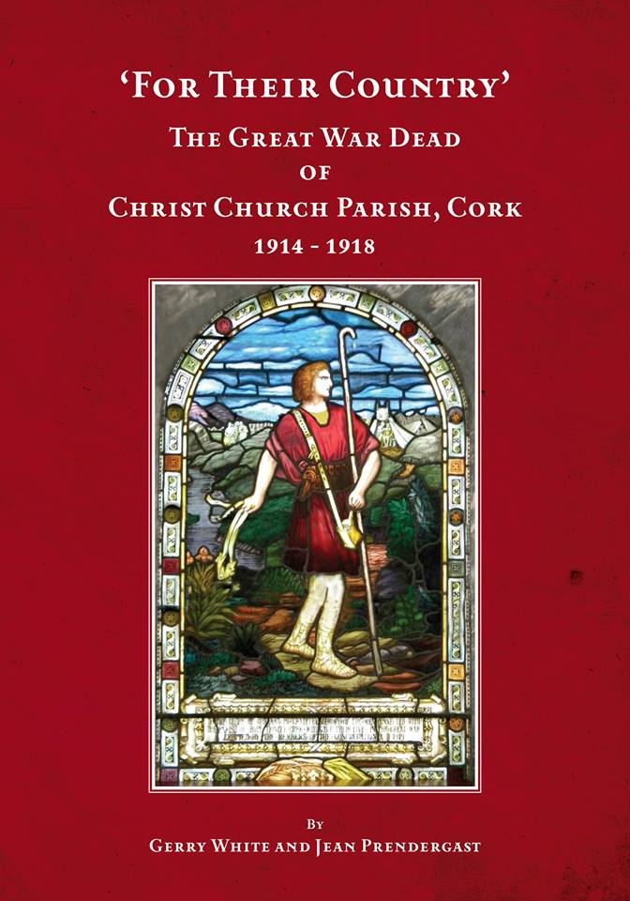
Publications

